Slide 1
Welcome To My Presentation On Tutor Management System
Name : Md.Shaharia Hasan
Id:210103
Session:2021-22

Slide 2
Key Features Of Tutor Management System….
1.Tutor and Student both can easily registration and login into this website.
2.Student can easily find their required tutor by using this website.
3.For tutor there is no hassle to find Tuition according their qualification.
4.Tutor and Student both can give their feedback how they benefitted or not.

Slide 3
Language used for developed this project.
1.FOR FRONTEND: I used here HTML,CSS,AND JAVASCRIPT.
2.FOR BACKEND:I used here NODE.JS
3.FOR DATABASE: I used here NON SQL database MONGODB.

Slide 4
Here I am starting to show you the every pages and subpages of my Tutor Management System Project.
Lets show the pages….

Slide 5
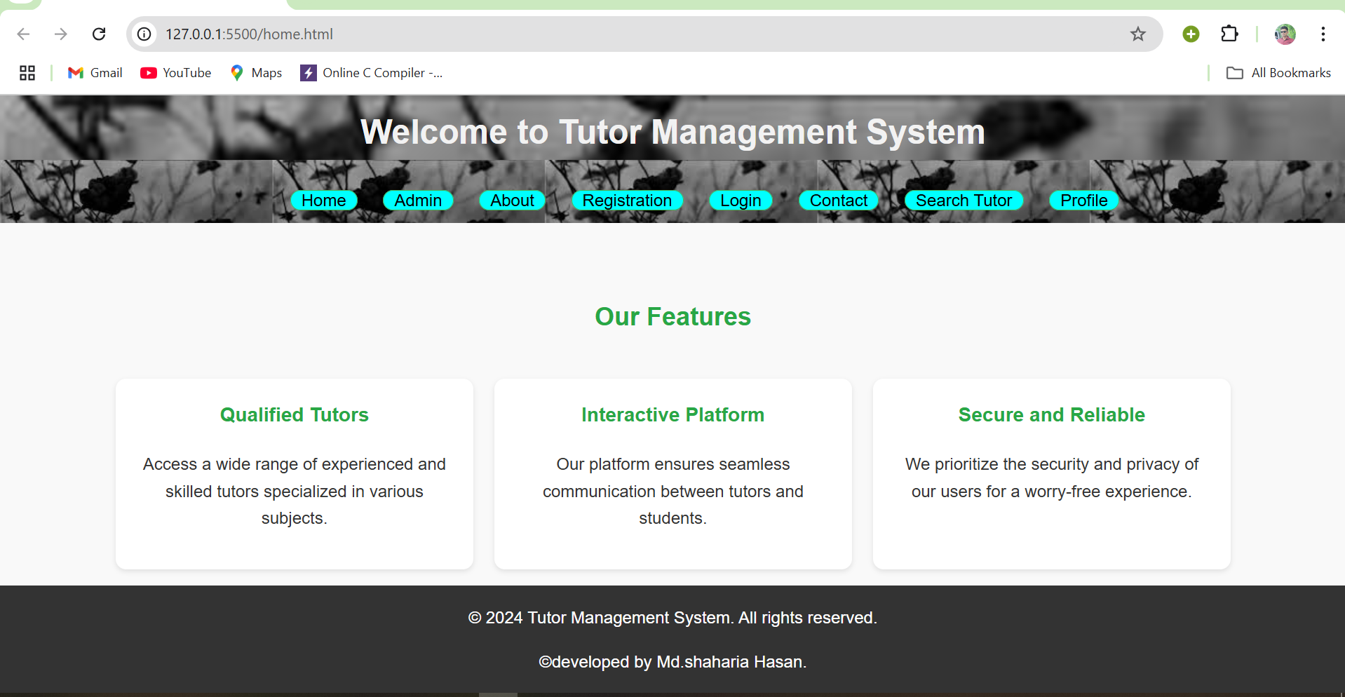
Homepage of my project..

Slide 6
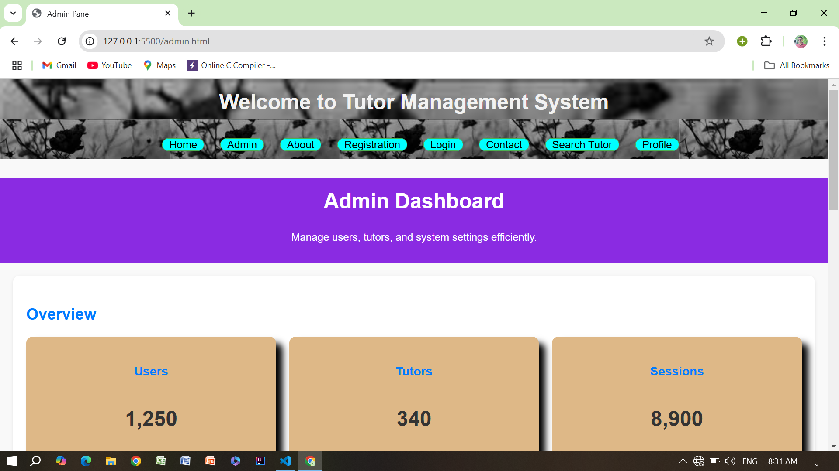
Admin Section of my project…

Slide 7
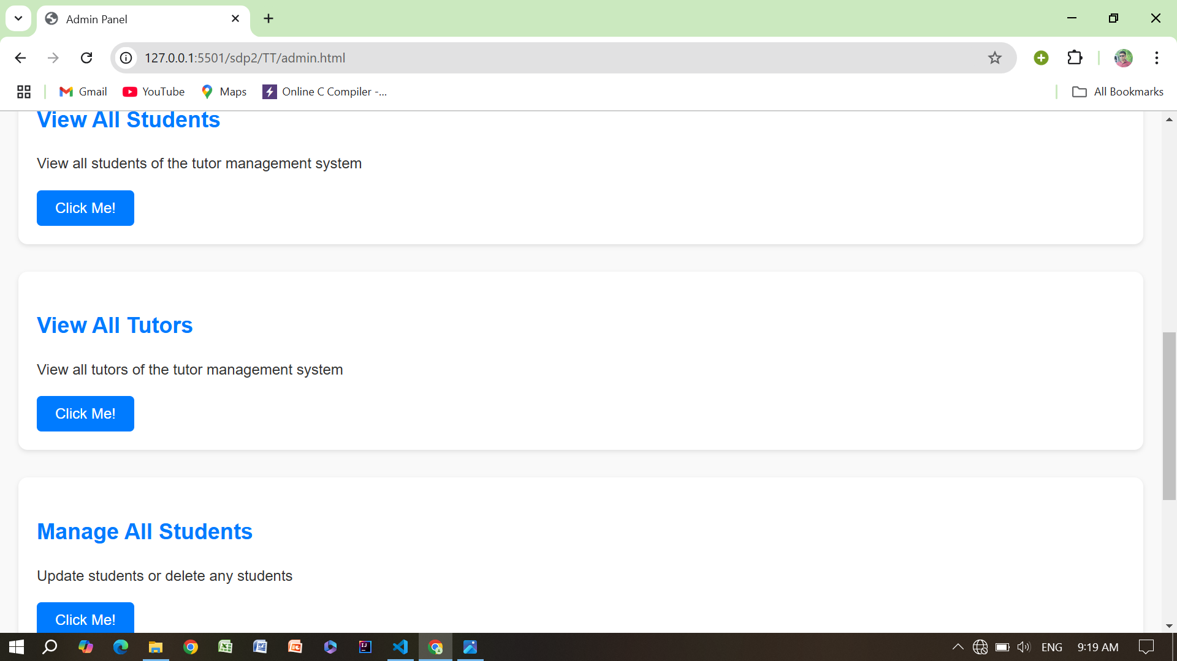
Admin can do here…

Slide 8
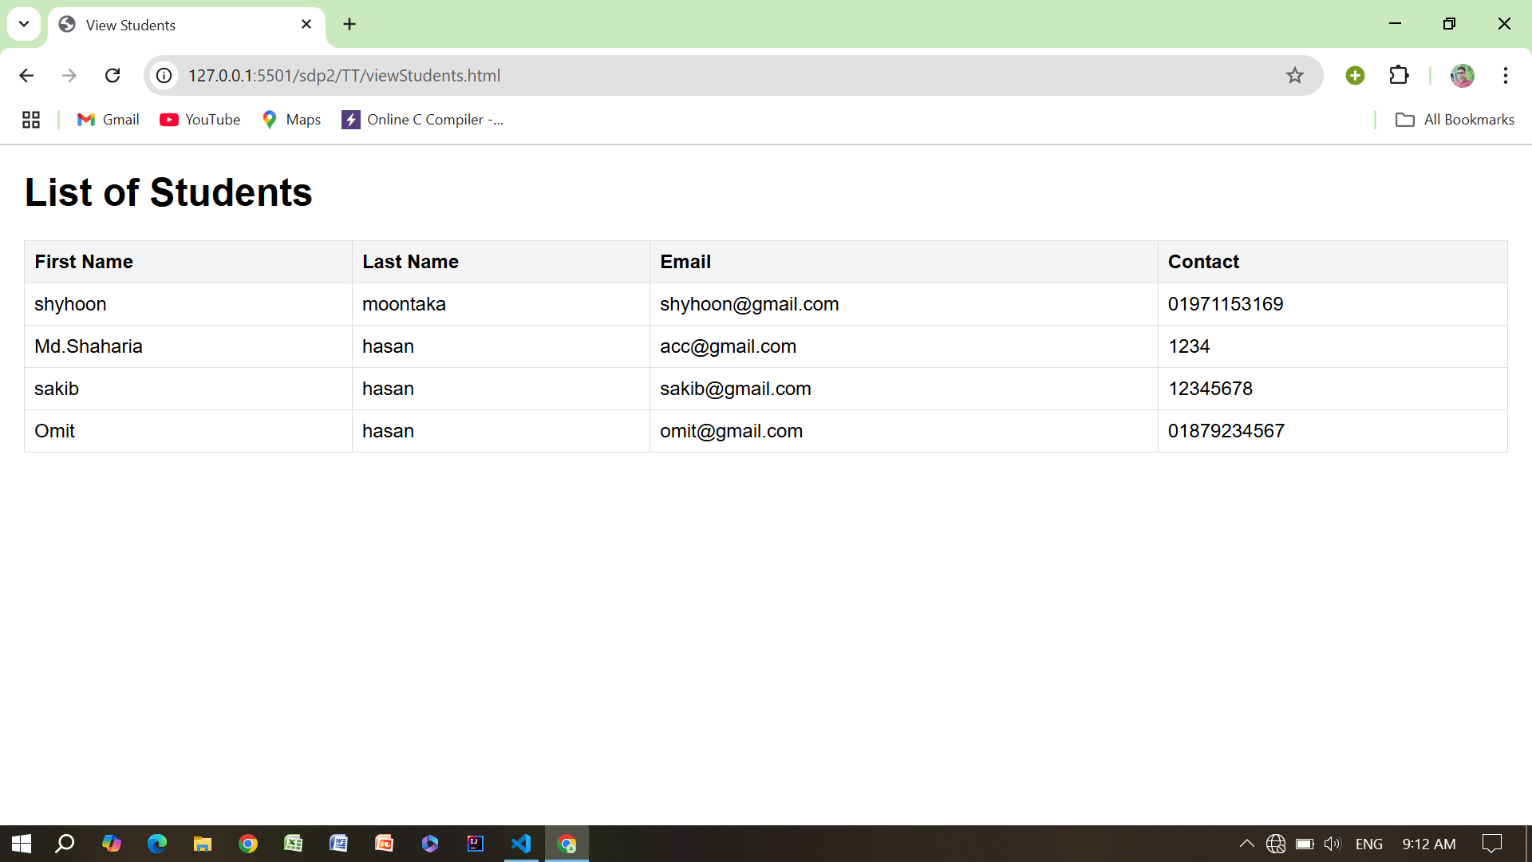
Admin can View all Students.

Slide 9
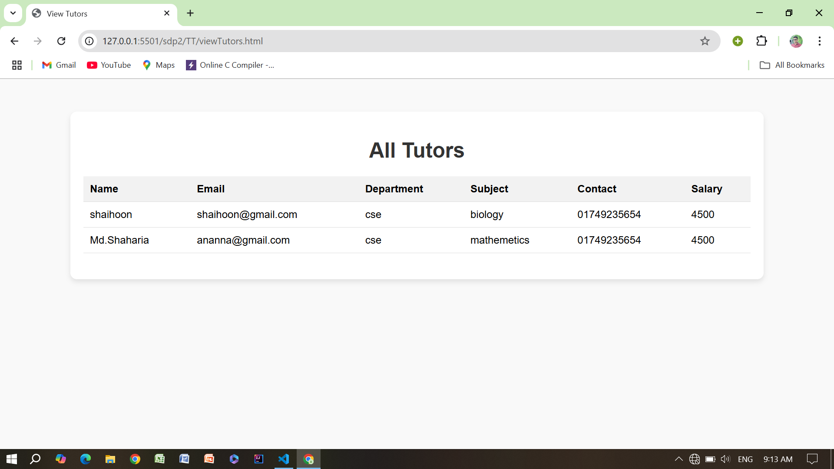
Admin can View all Tutors.

Slide 10
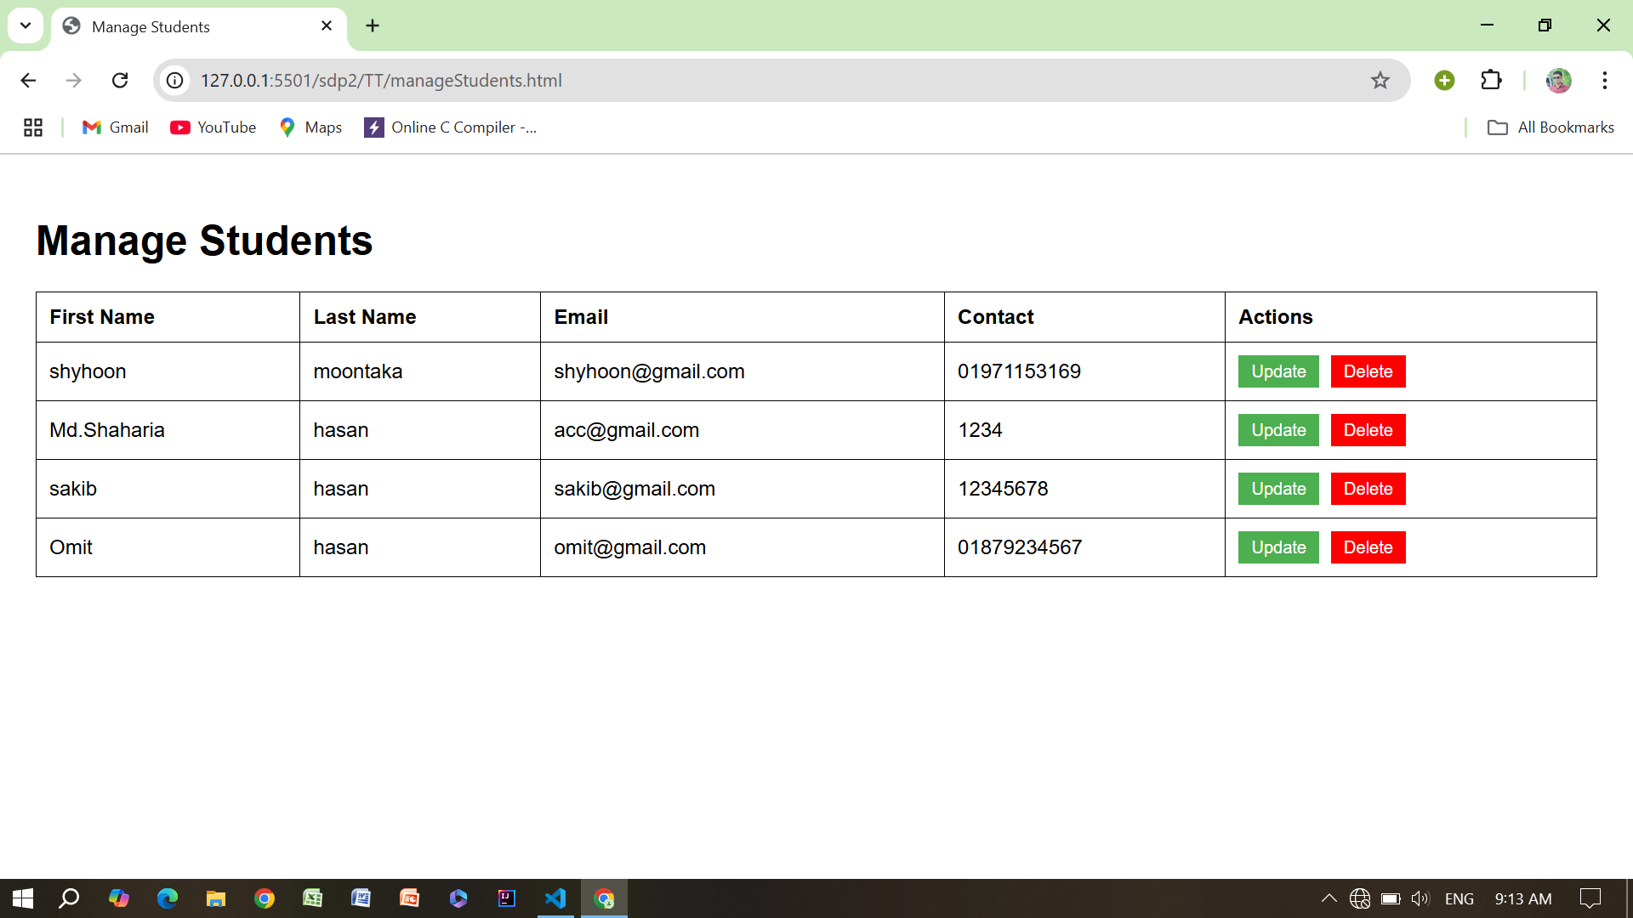
Admin can Update information of all Students.

Slide 11
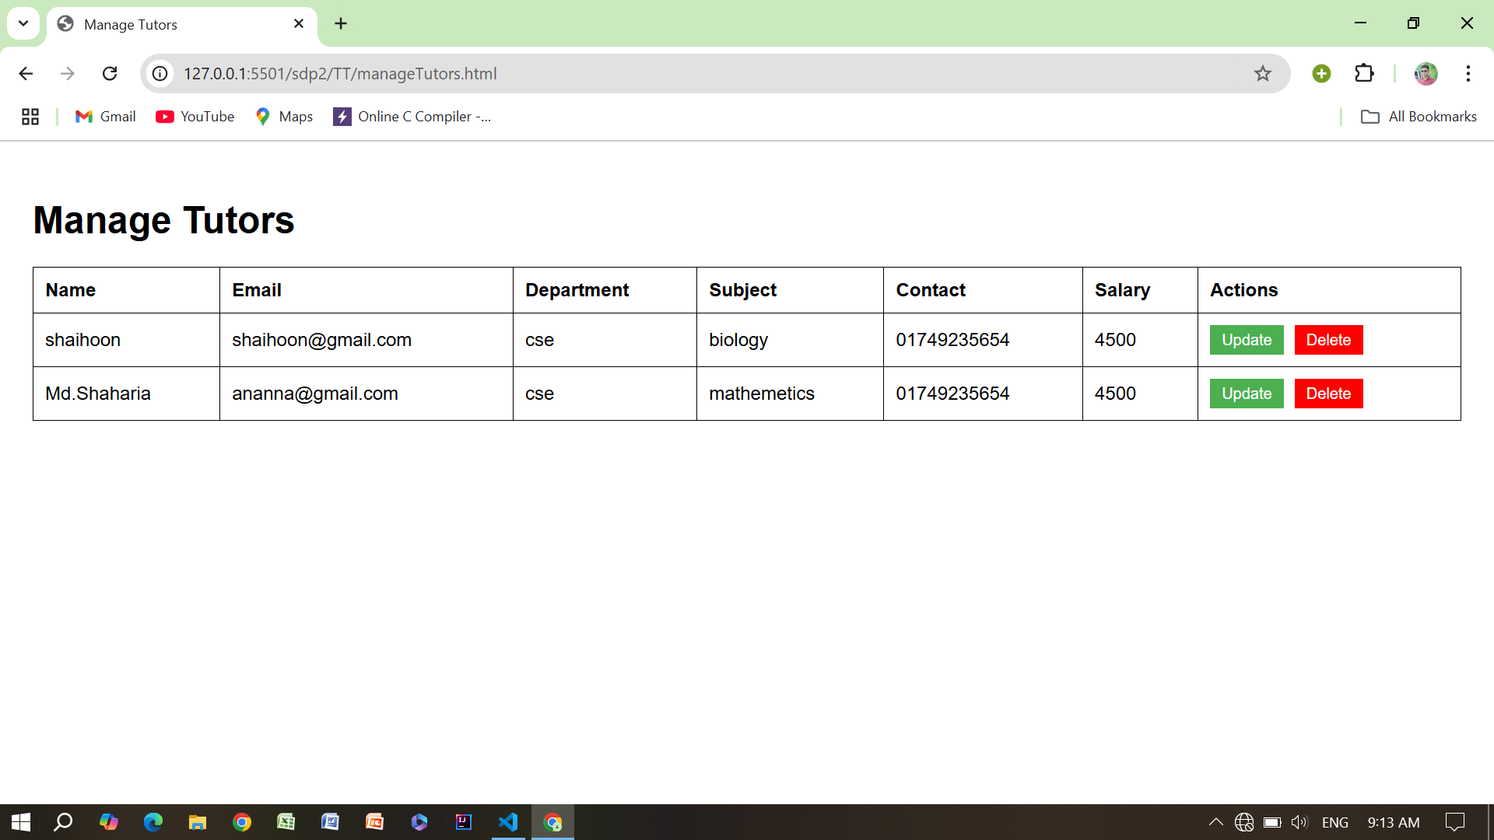
Admin can Update all information of all Tutors.

Slide 12
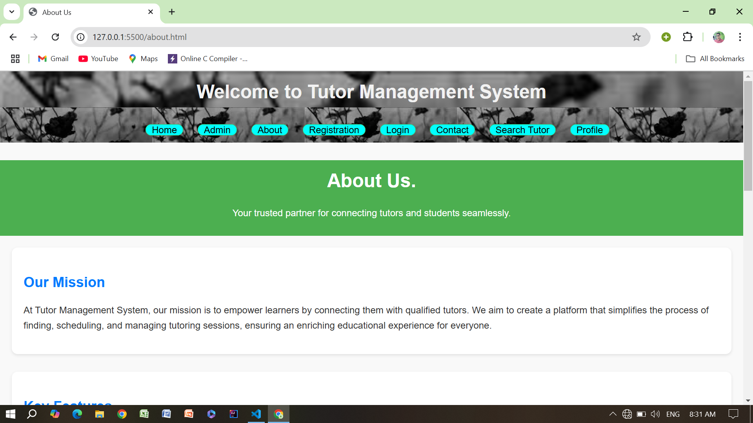
About Section of my Project…

Slide 13
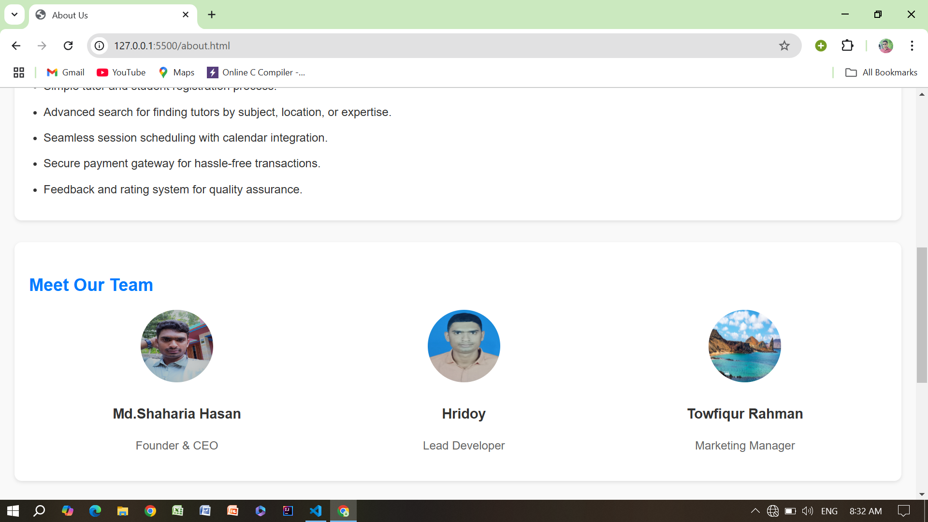
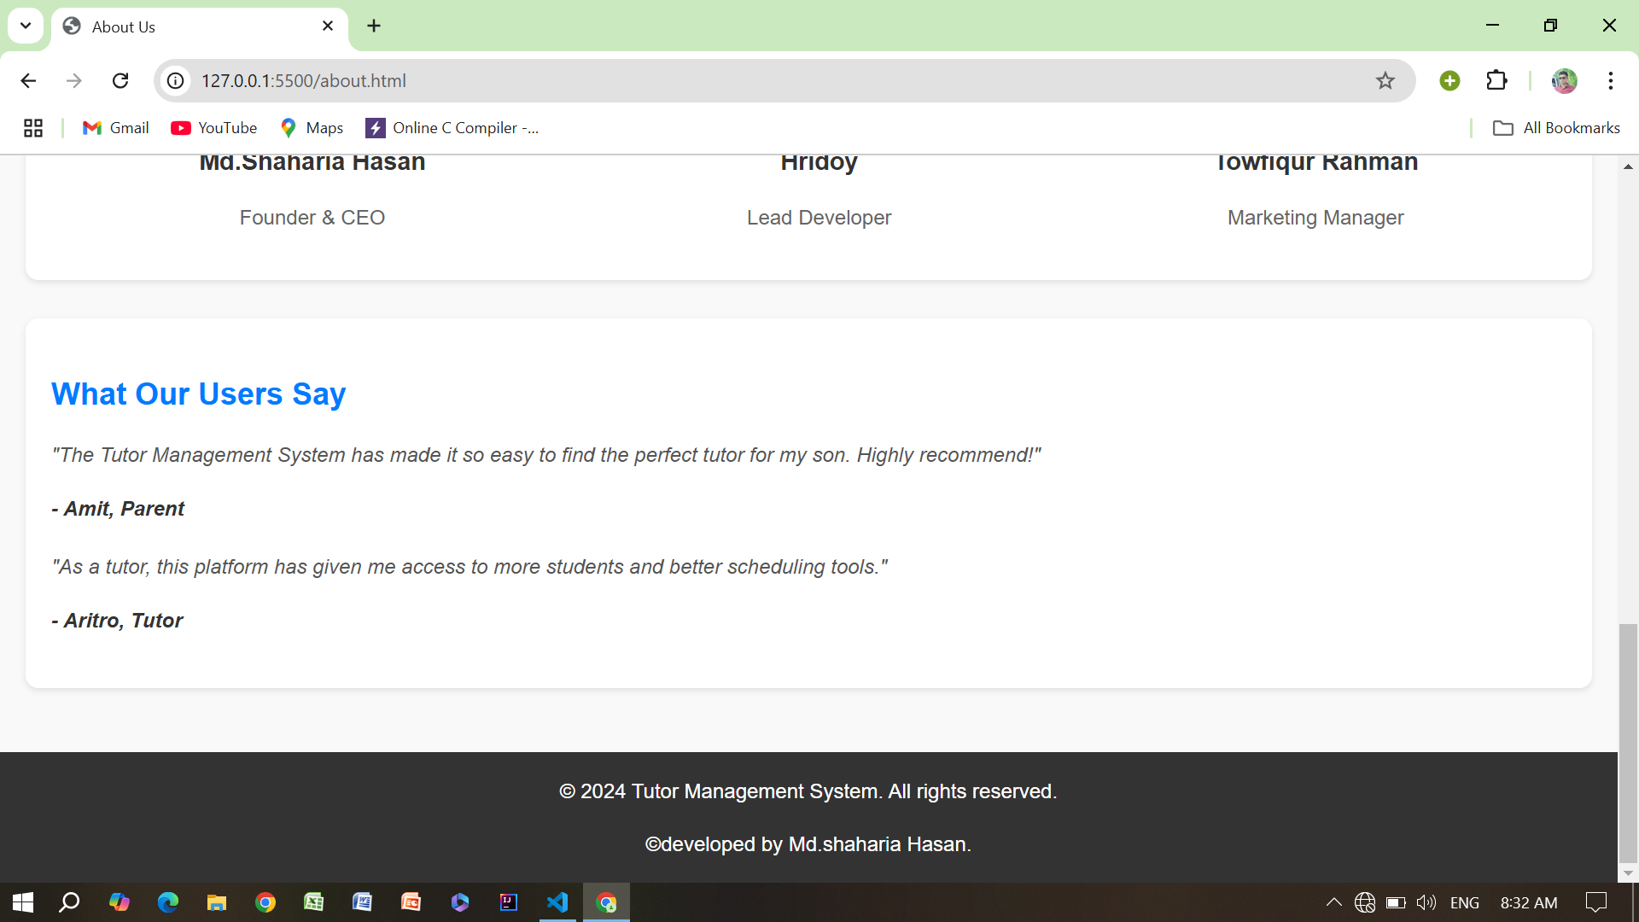

Slide 14
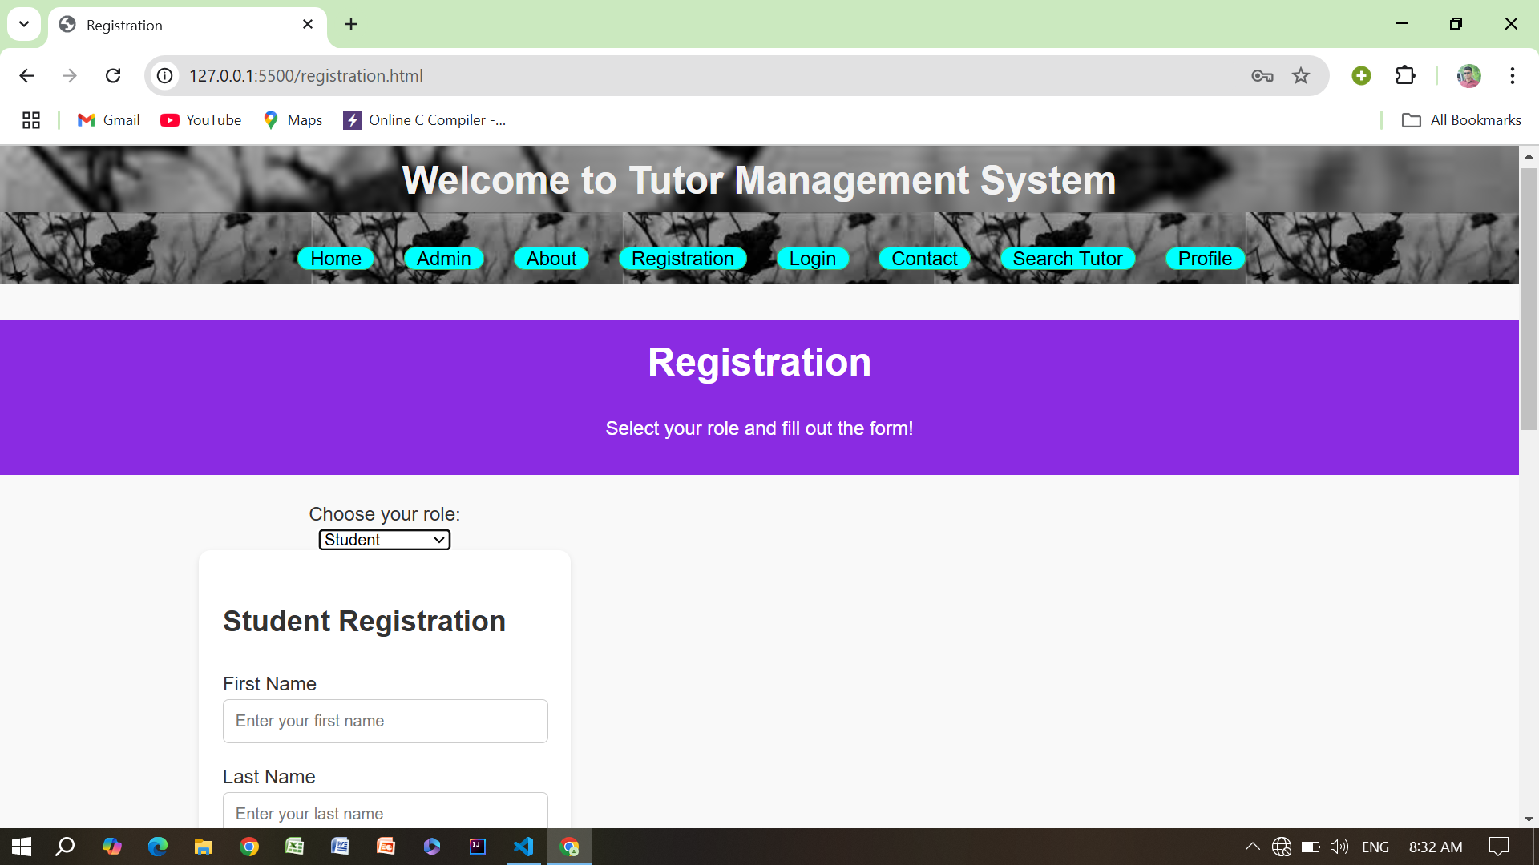
Registration Section….

Slide 15
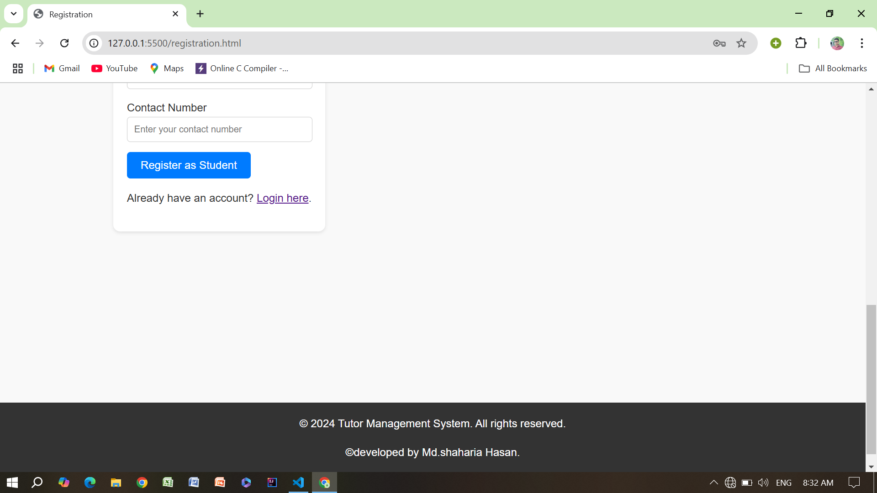

Slide 16
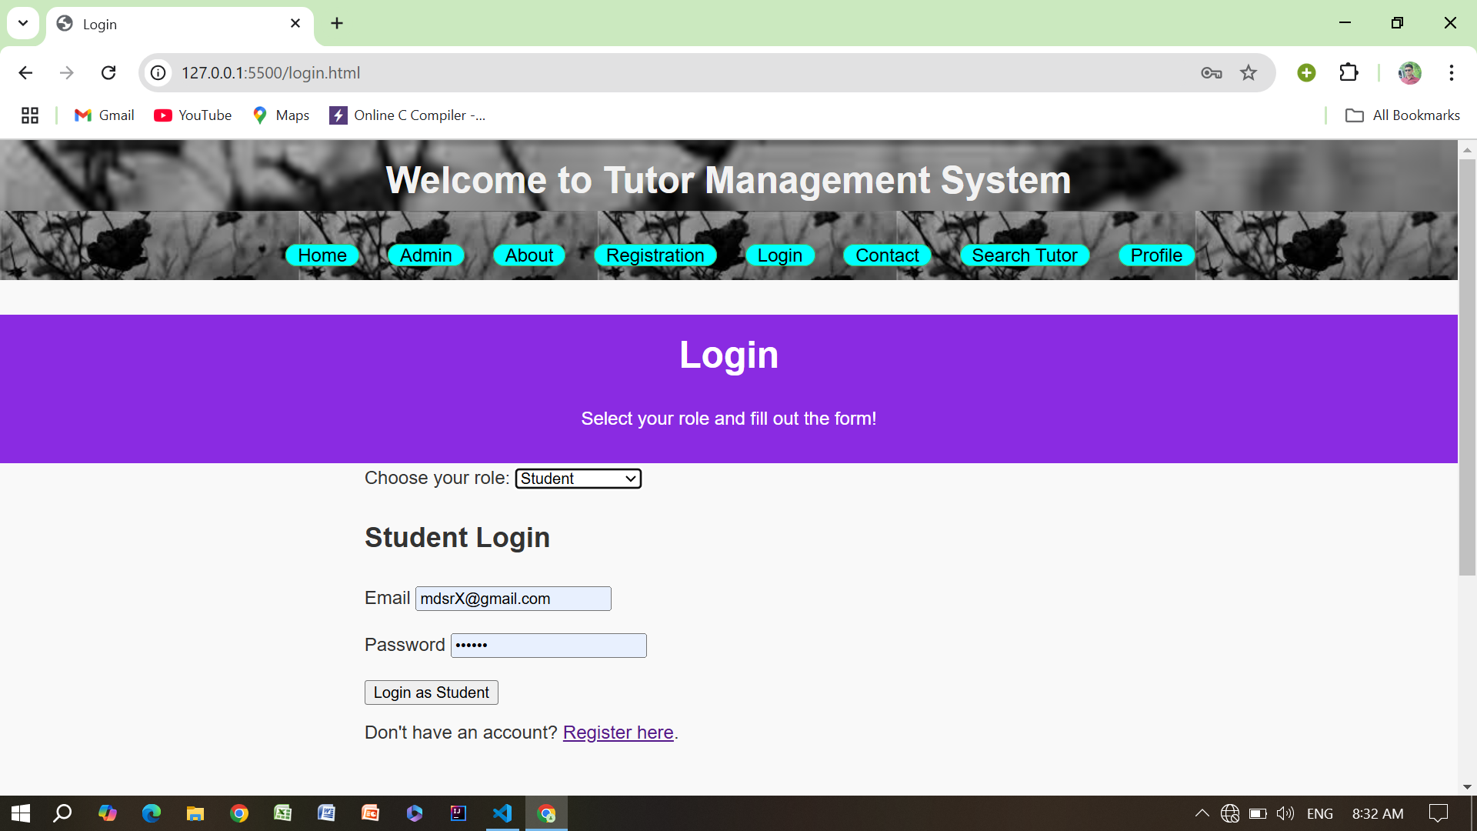
Login Section….

Slide 17
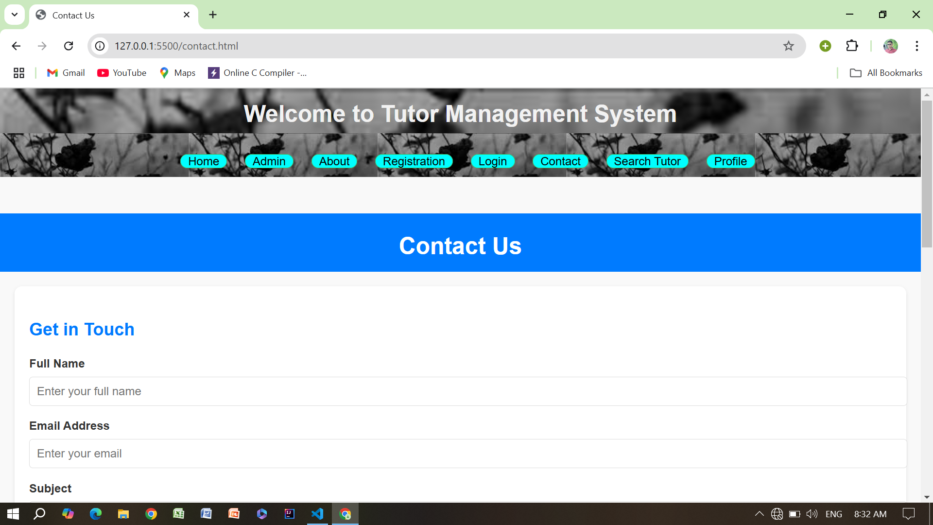
Contact Section….

Slide 18
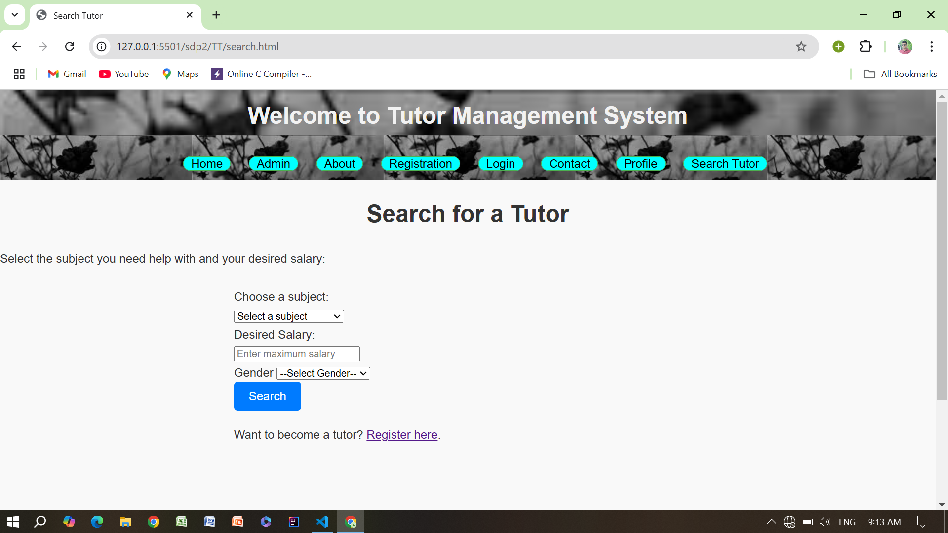
Search Tutor Section …

Slide 19
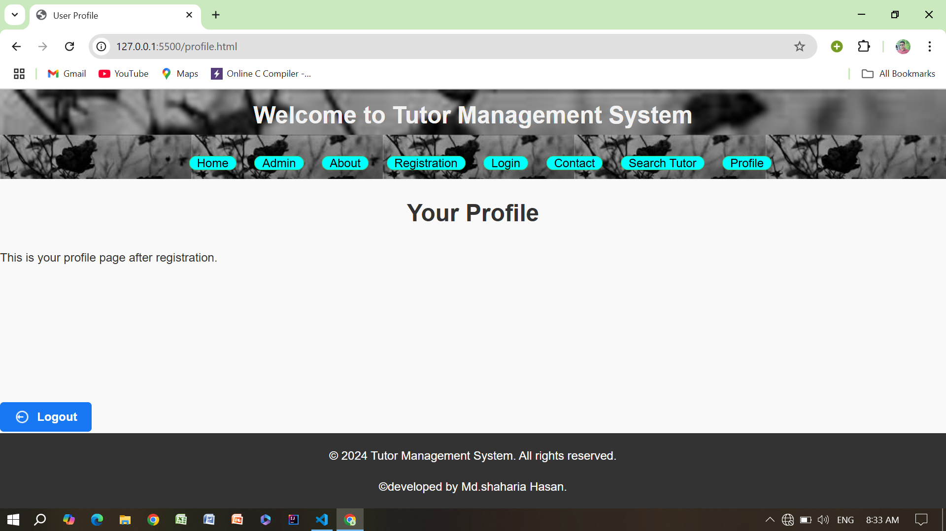
Profile Section…

Slide 20
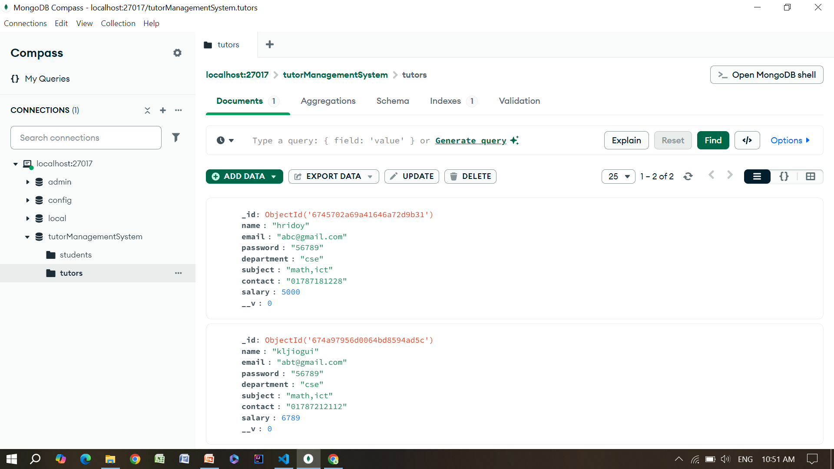
Connect data base in mongo db….

Slide 21
Thank you for your attention!

